Slide 1
Project Management & Research Methodology IS4S706
Research Methods

Slide 2

Hello!
Sharon Latham
Faculty Librarian – Computing, Engineering, Science (FCES)
sharon.latham@southwales.ac.uk
Email me

Slide 3
Session Goals
Research Tips and Tricks
Searching Techniques
Introduction to FINDit – USW library resources
Introduction to Subscription Databases
Introduction to Google Scholar
Further Help and Support

Slide 4


Slide 5

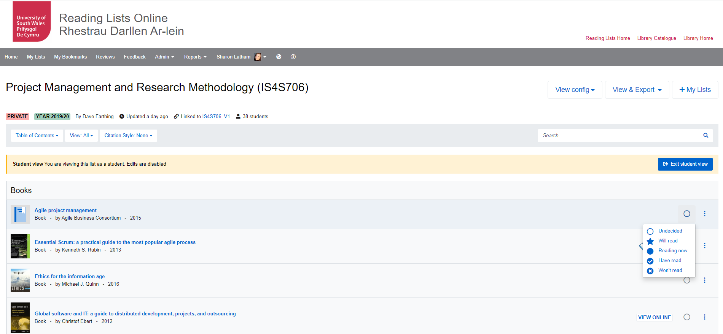
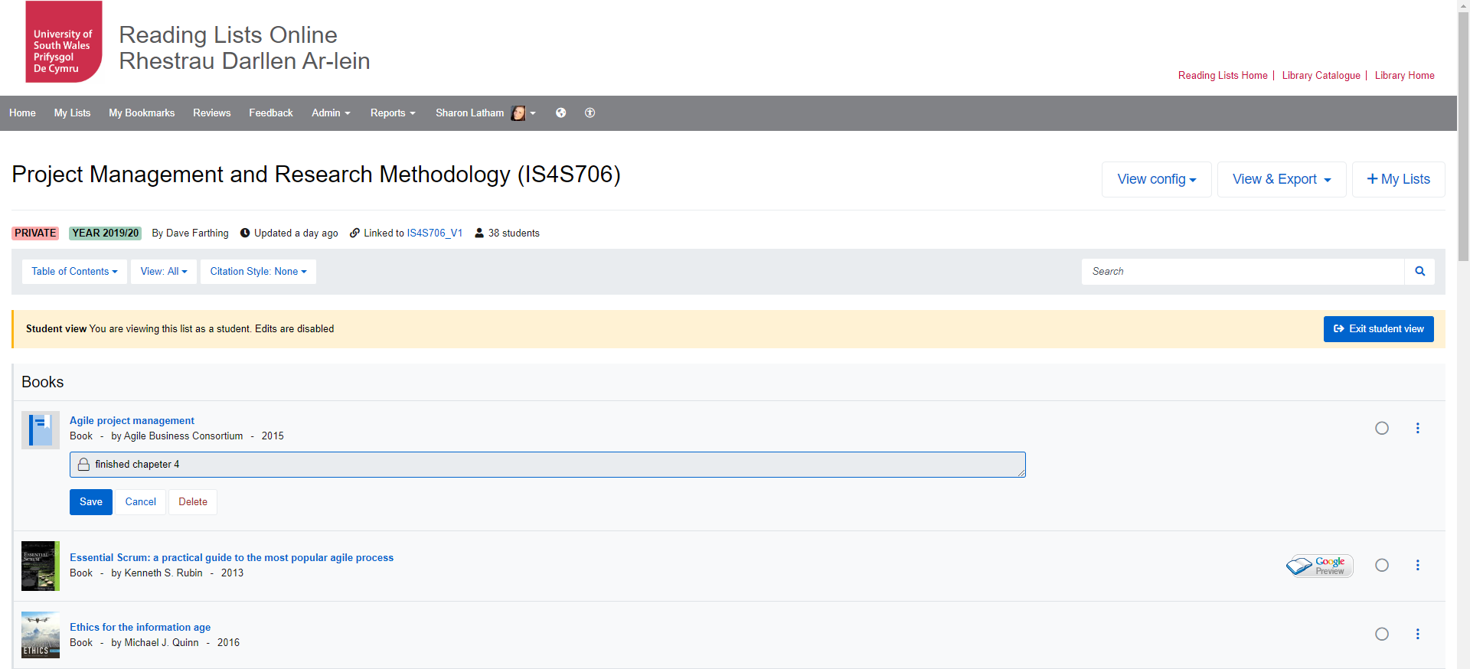

Reading List – Blackboard link
Sign in
You can set your reading intentions and make notes if you sign in.
https://rl.talis.com/3/southwales/lists/070E6D7A-D539-D71D-795A-479179945A46.html?lang=en&login=1

Slide 6


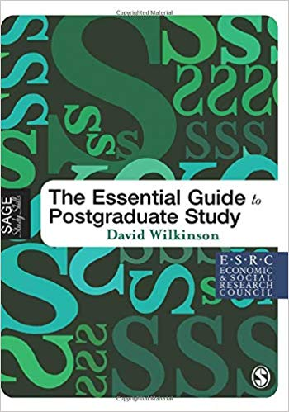

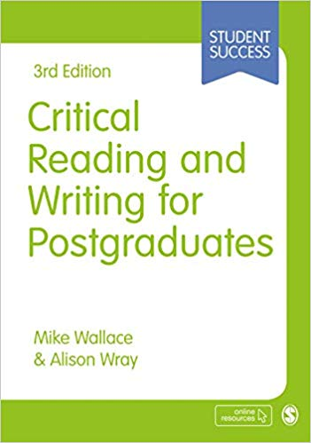
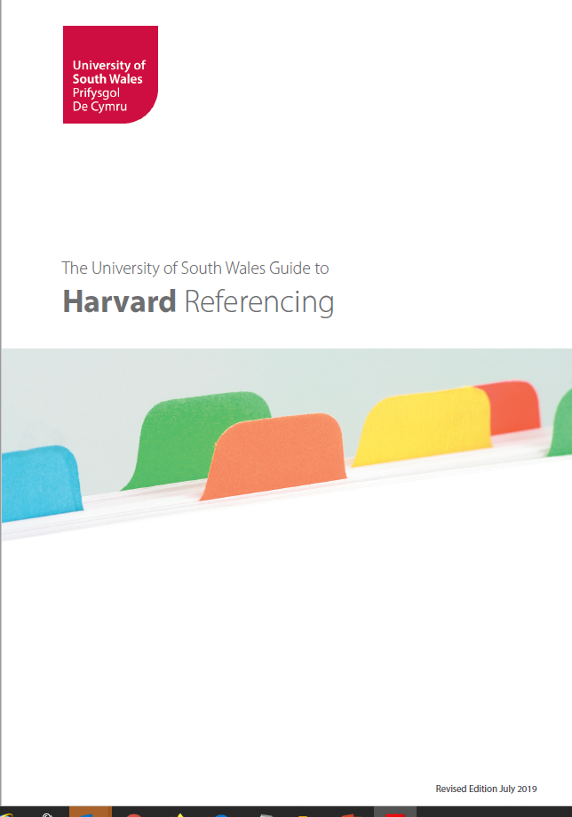

Self Help books
We have lots of books to help with your academic skills. Here are just a few of them.
Download a copy of USW Harvard Referencing. Our style is based on Cite them Right – available for loan in the library

Slide 7
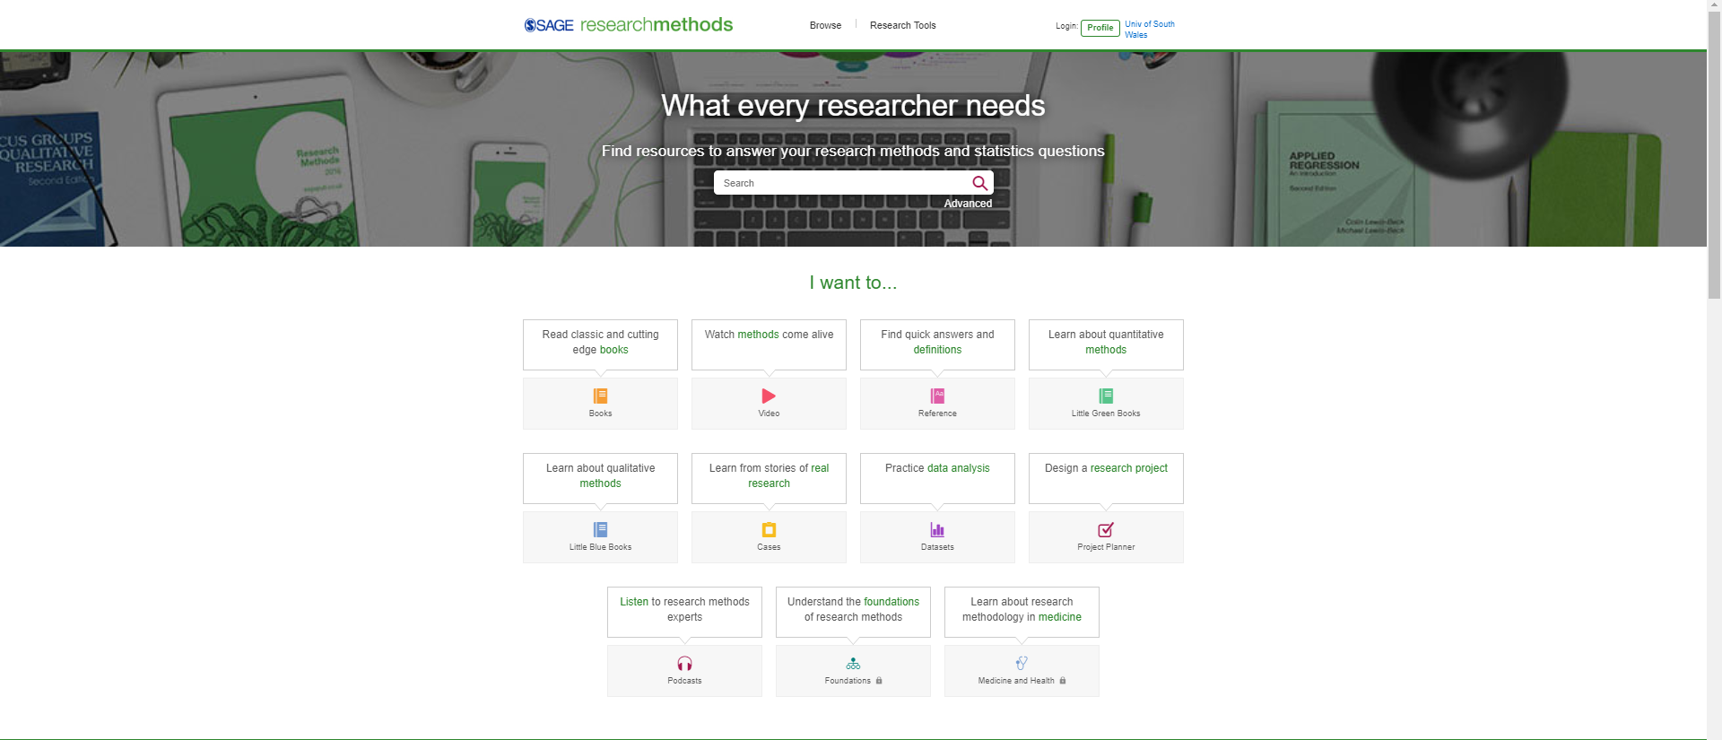

Use Sage Research Methods Database
https://libguides.southwales.ac.uk/SAGE

Slide 8
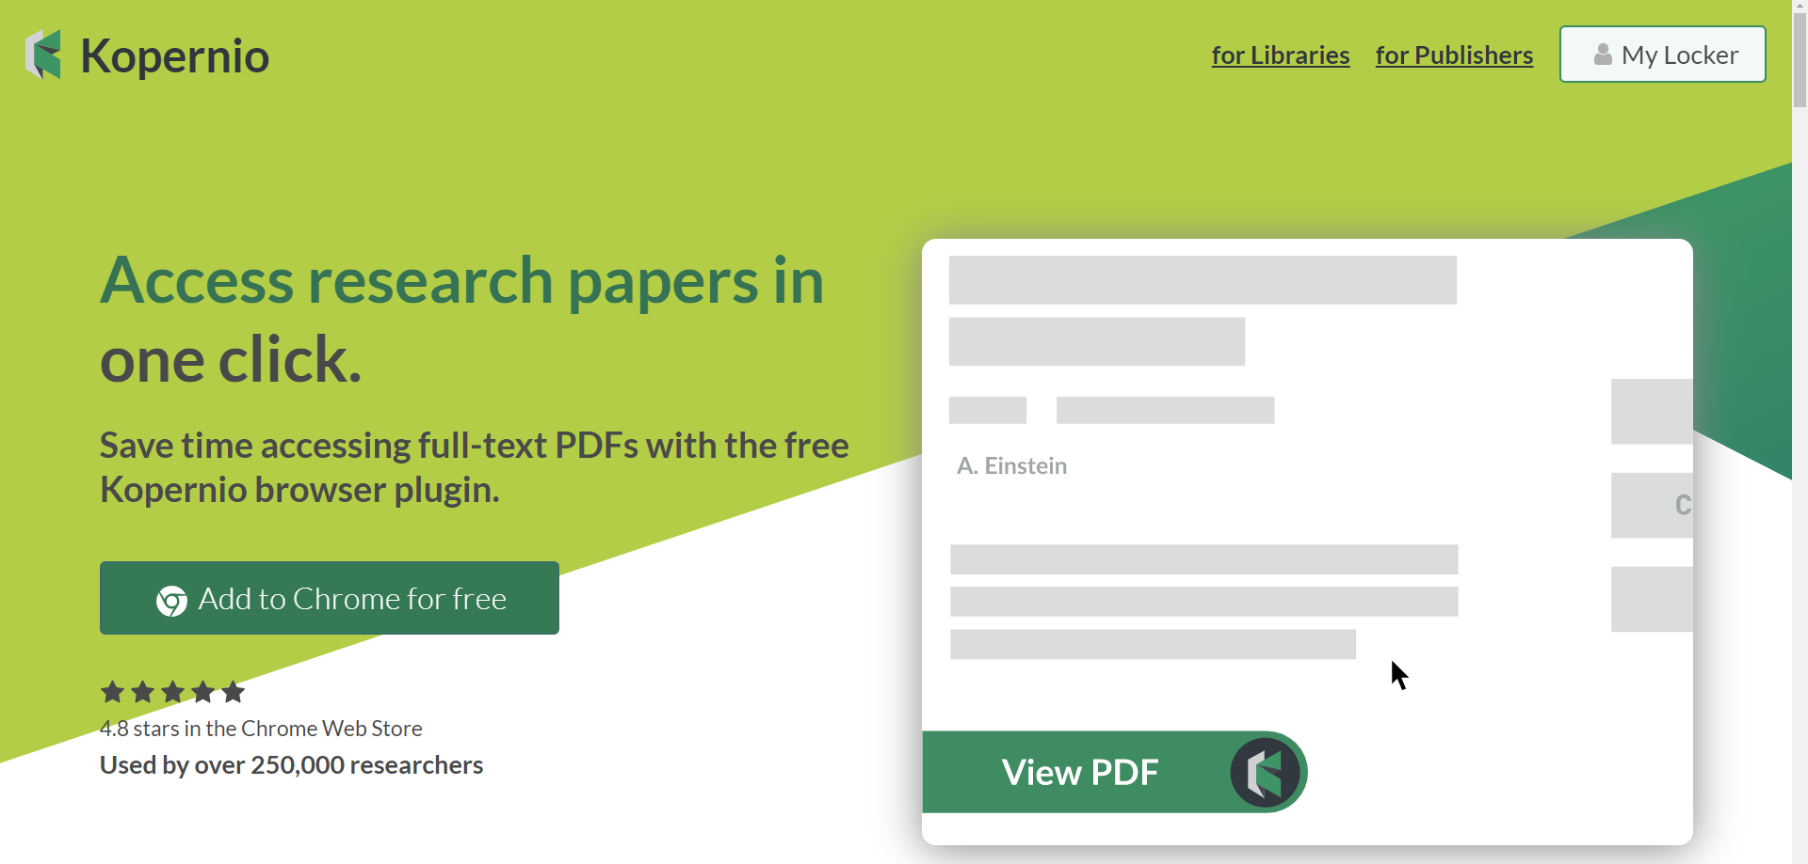
Add this plug in to chrome – it tells you if the PDF is available online or through our subscriptions – very useful
https://kopernio.com/

Slide 9
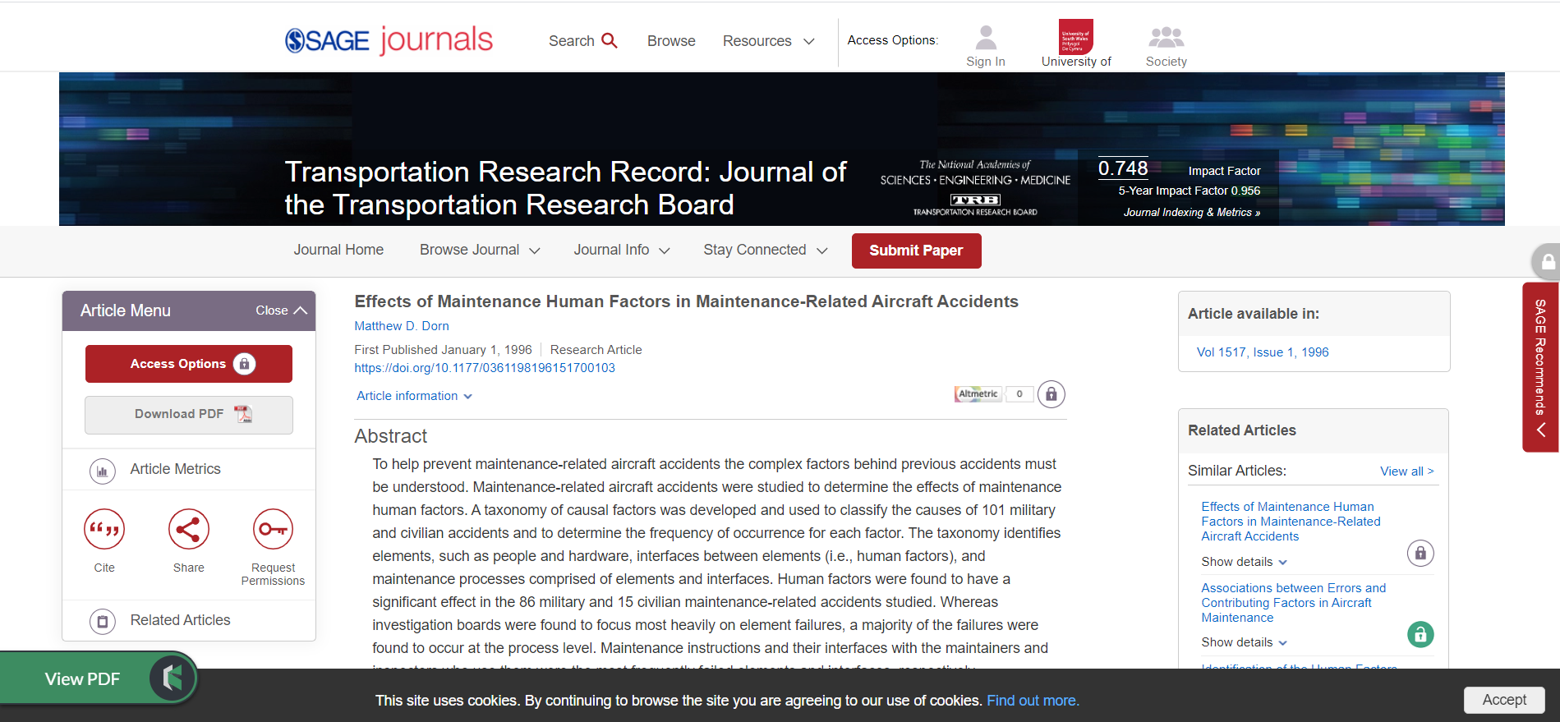

Slide 10
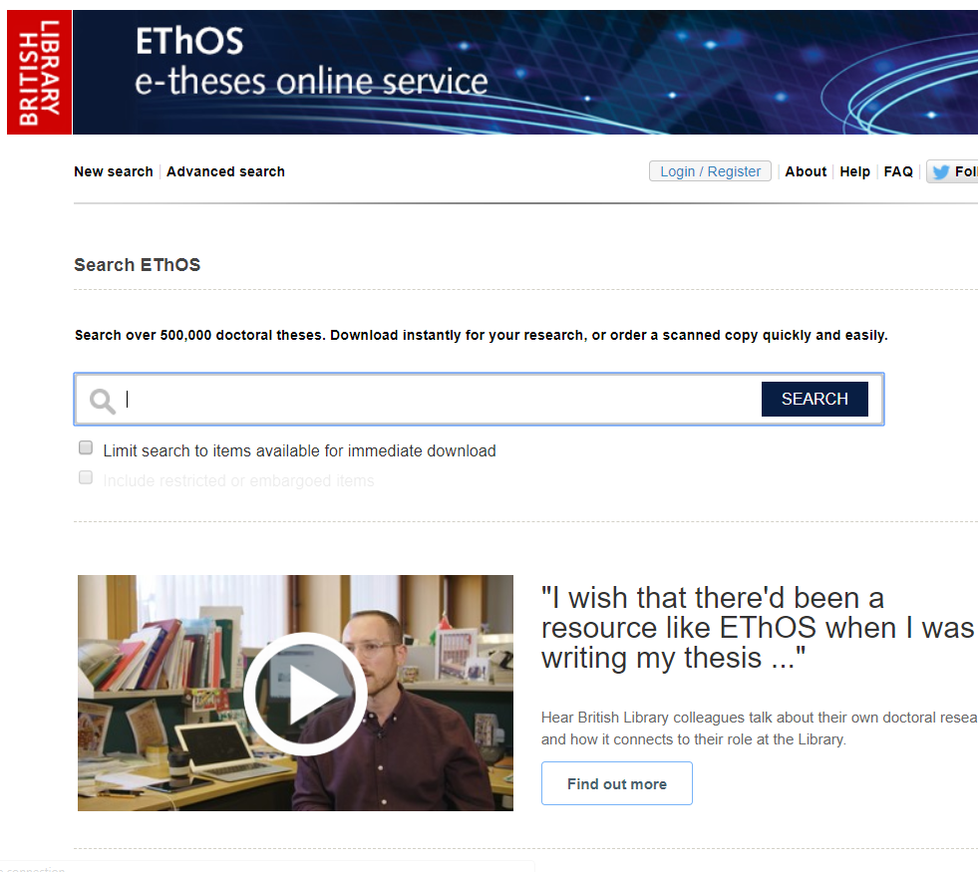
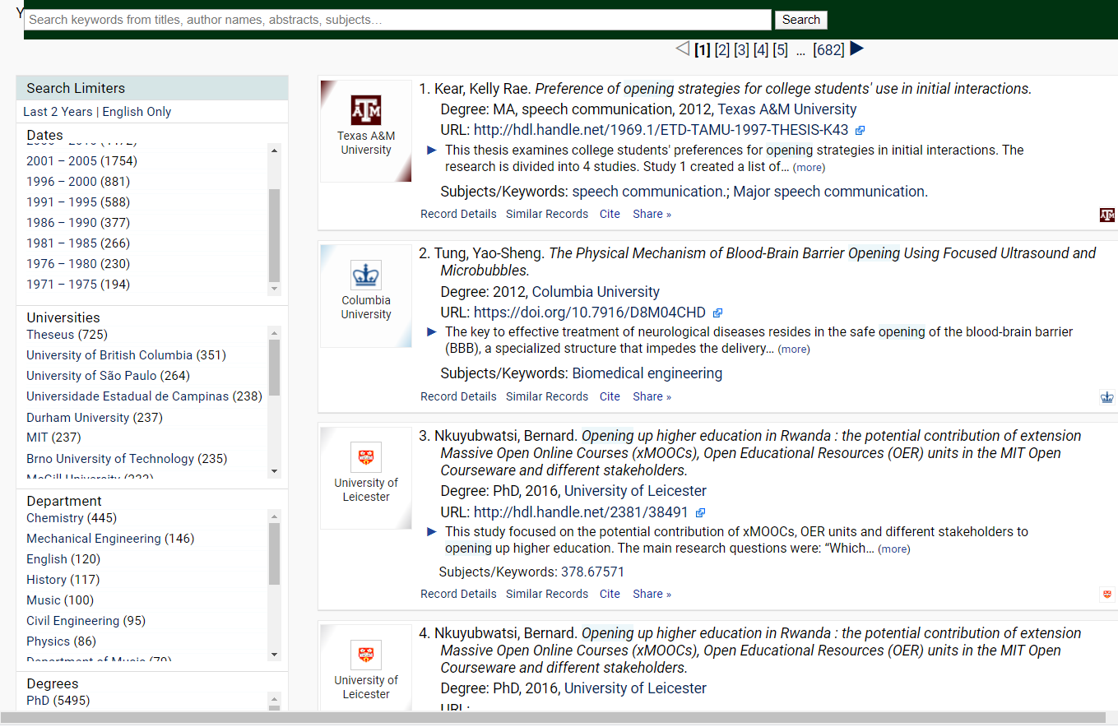
Find Dissertations and theses online
Ethos - Search over 500,000 doctoral theses. Download instantly for your research, or order a scanned copy quickly and easily.
OATD - Open Access Theses and Dissertations. Advanced research and scholarship. Theses and dissertations, free to find, free to use.

Slide 11


Investigate Bibliographic Management Software
All have free versions
USW offer Endnote for the reduced price of £98.00 (£218)

Slide 12

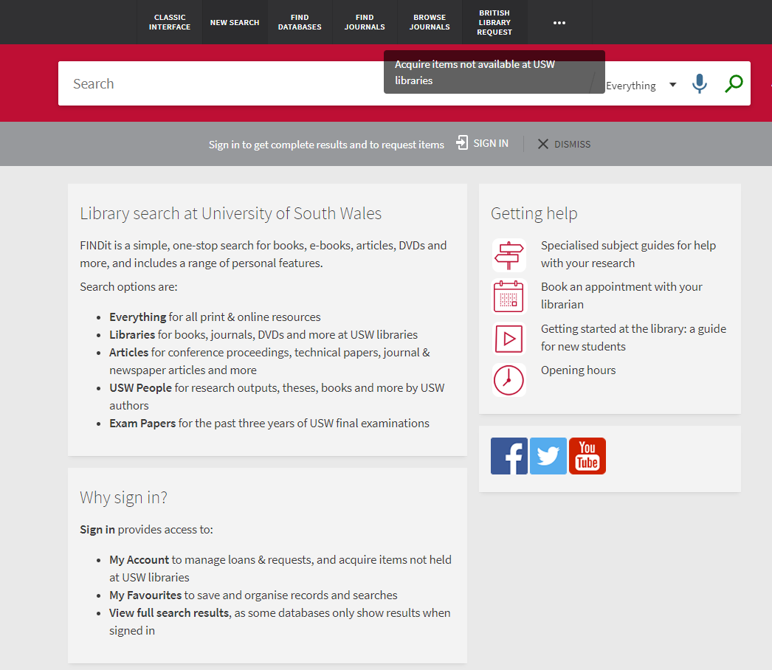
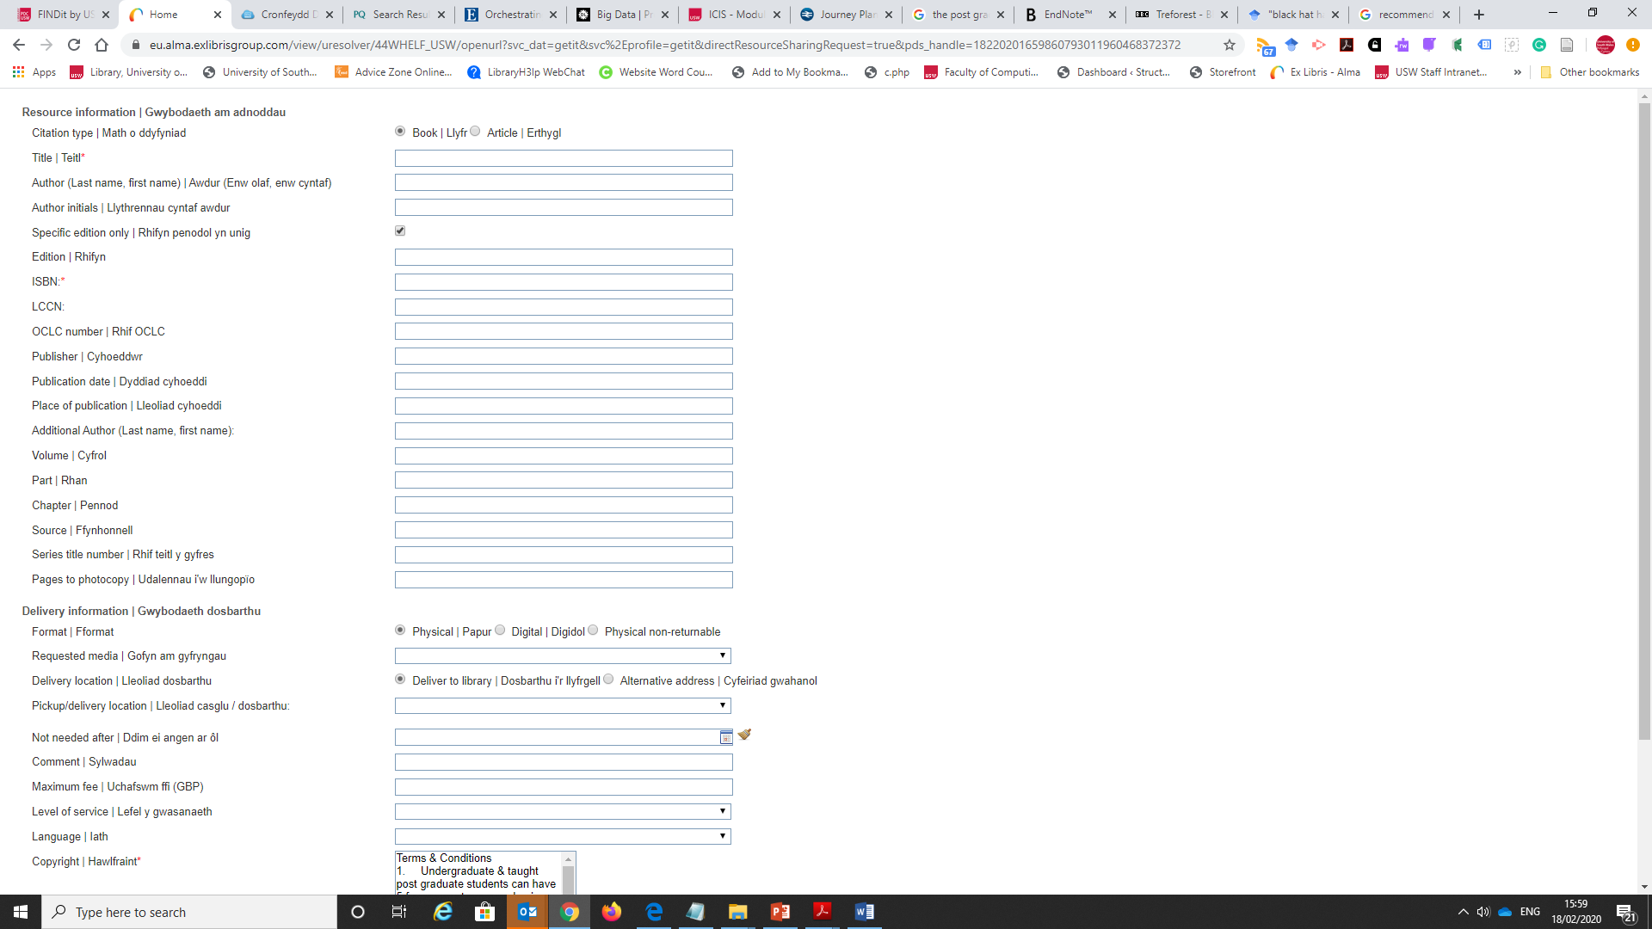
If we don’t have a book or access to a journal article
Let me know your recommendations
Use the British Library request service.

Slide 13

Searching Techniques

Slide 14


Slide 15
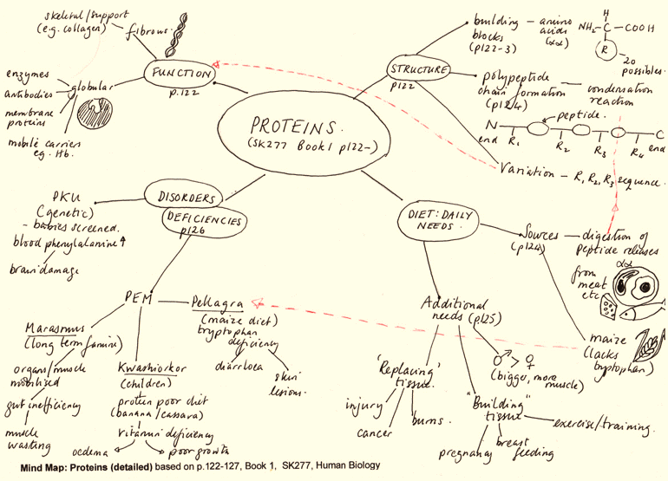
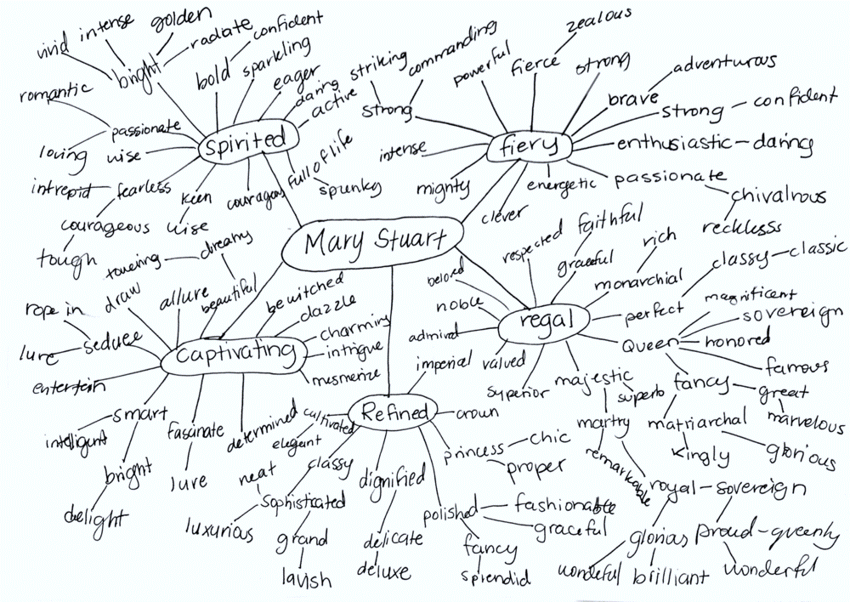
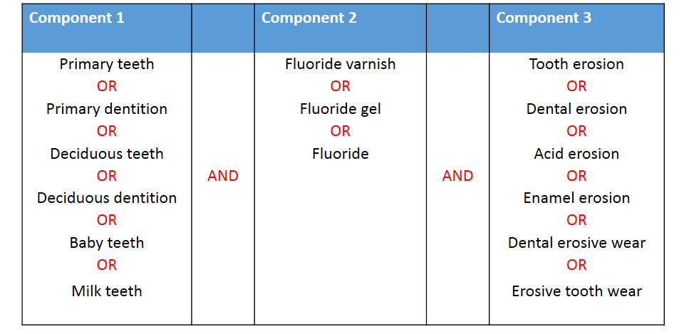
Develop a search strategy:
Draw a mind map or grid
Synonyms, related terms, alternative words
Use a thesaurus e.g. thesauras.com
Discuss with others
Expand the list
Be Patient
Notes:
http://www.thesaurus.com/

Slide 16








Boolean Operators (use capitals in search box or pull down menu)
AND – Narrow search Articles will contain both the words
Black hat hacking Law
OR – Wider search Articles will contain either word
Grey hat OR White Hat
NOT - Narrow and very specific Articles will exclude one term
White Hat NOT Black Hat

Slide 17
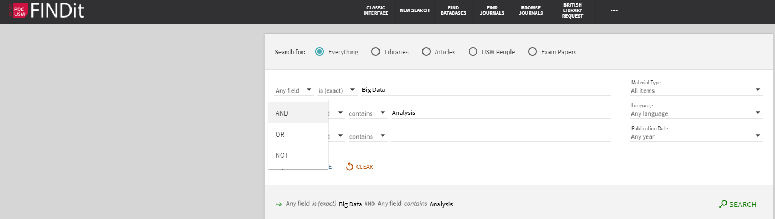
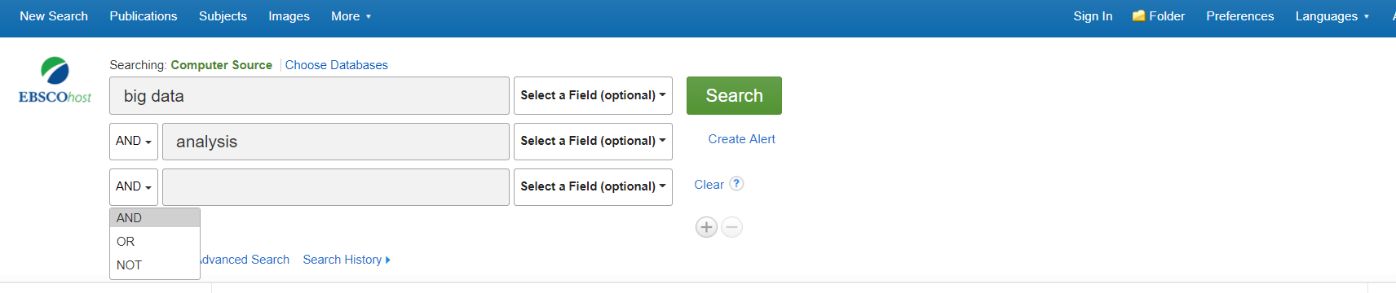
Or type in AND OR NOT – also + - in scholar

Slide 18
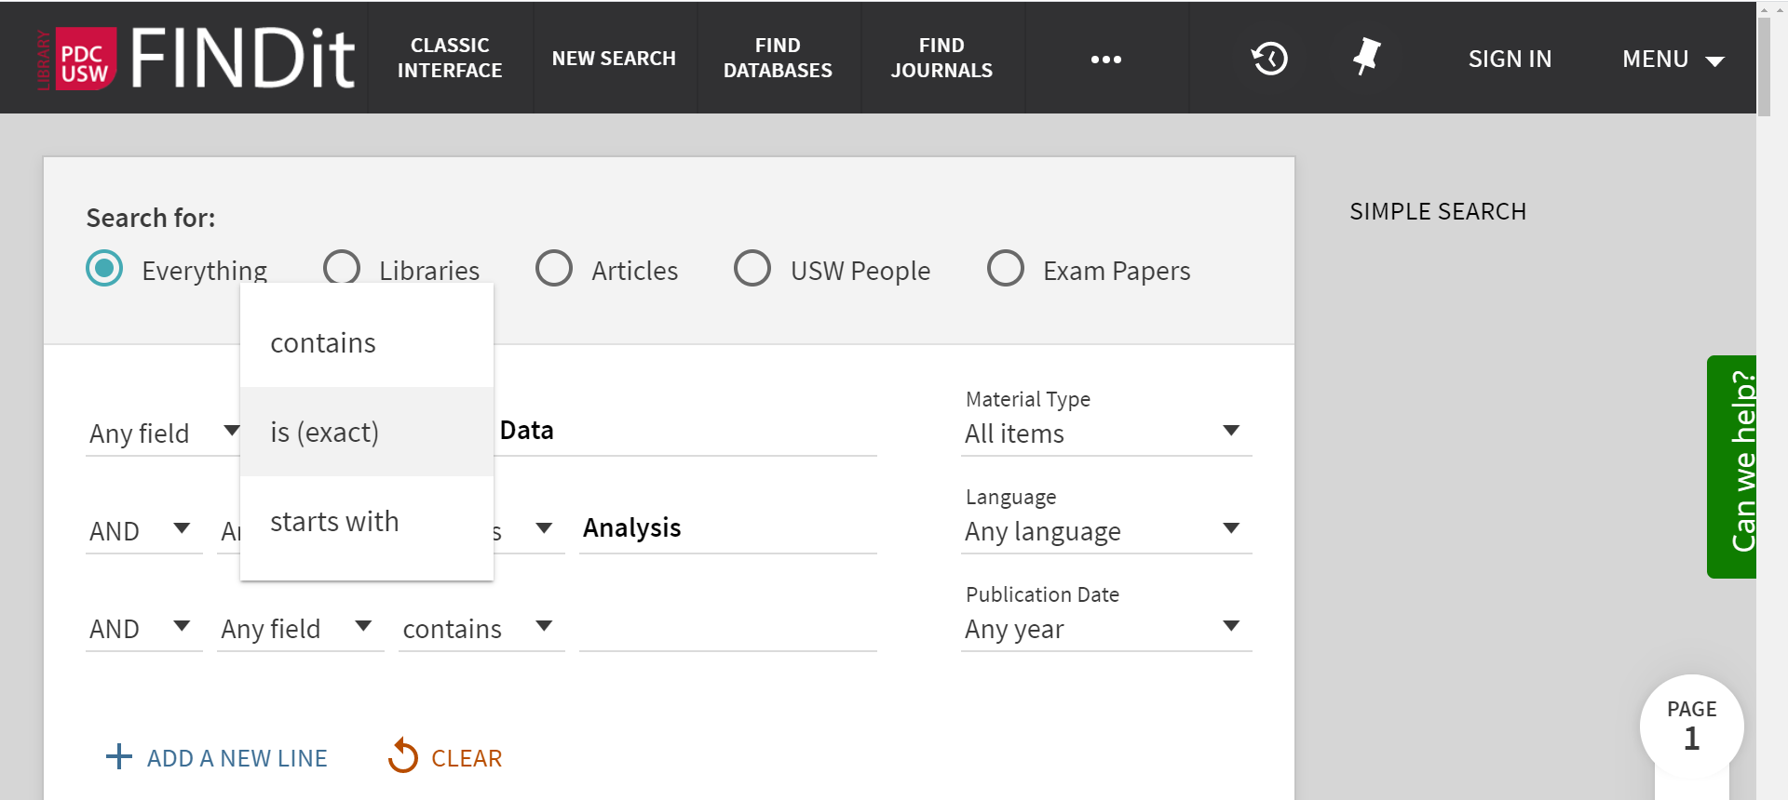


“
Good to know…
“
“Artificial Intelligence” “Cloud computing”
“Black hat hacking” “Risk analysis” “Data Mining”
PHRASE SEARCH
government* governments
governmental
governmentally
TRUNCA
TION
Wom*n = Women or Woman
WILDCARD

Slide 19
“
Good to know…
“
“Artificial Intelligence” “Cloud computing”
“Black hat hacking” “Risk analysis” “Data Mining”
PHRASE SEARCH
government* governments
governmental
governmentally
TRUNCA
TION
Wom*n = Women or Woman
WILDCARD

Slide 20
FILTERS – Refine Results

Slide 21
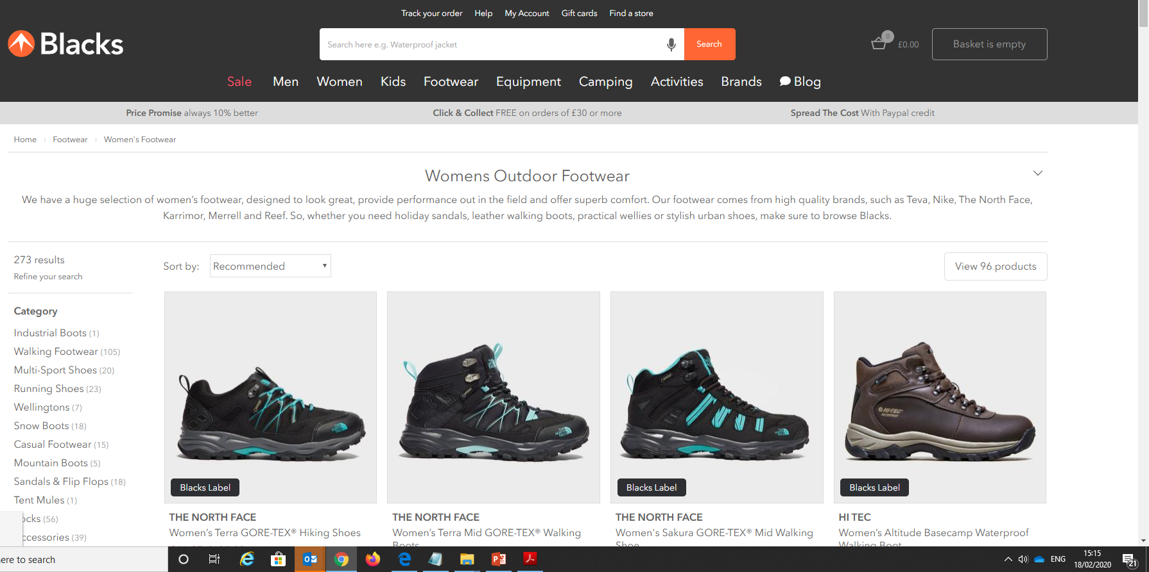
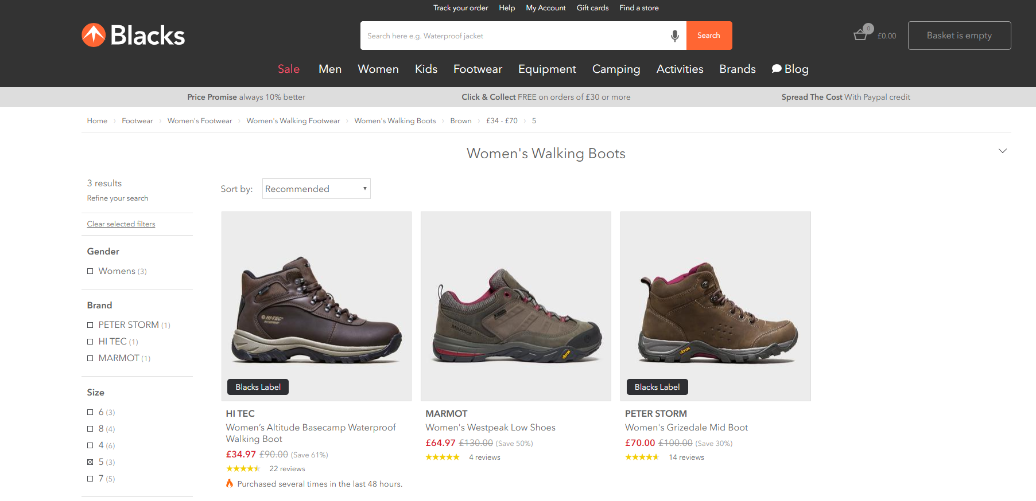
273 Results
I actually want is…
Walking boots
Size 5
Brown
Less than £70
3 Results

Slide 22
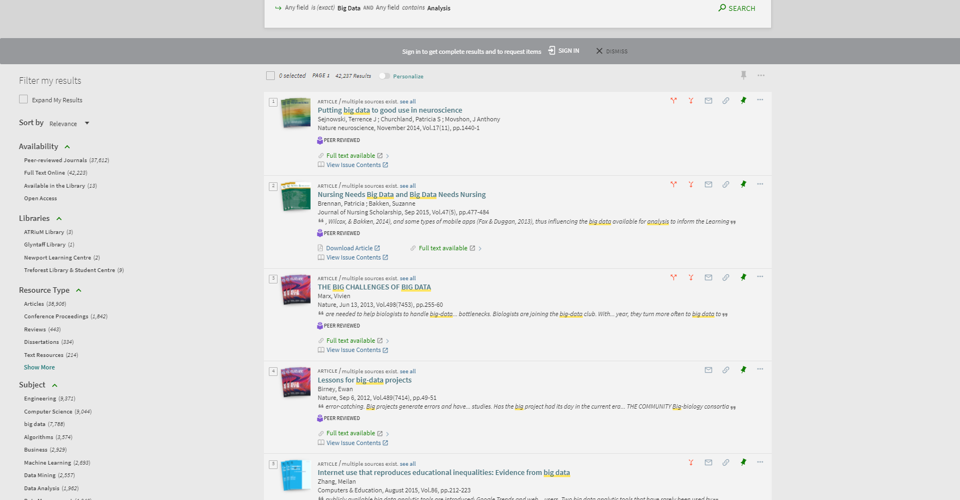

Slide 23
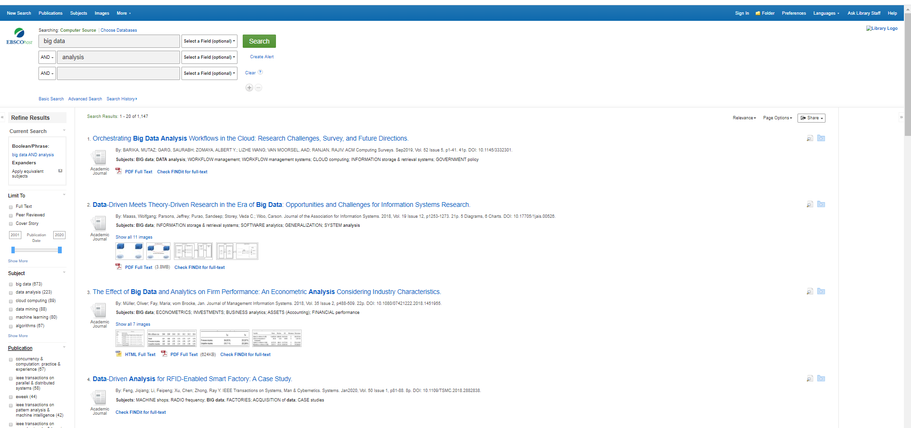

Slide 24
FINDitDemo
Sign in
Find a book
Find a journal article
Pin an item
Set an alert

Slide 25
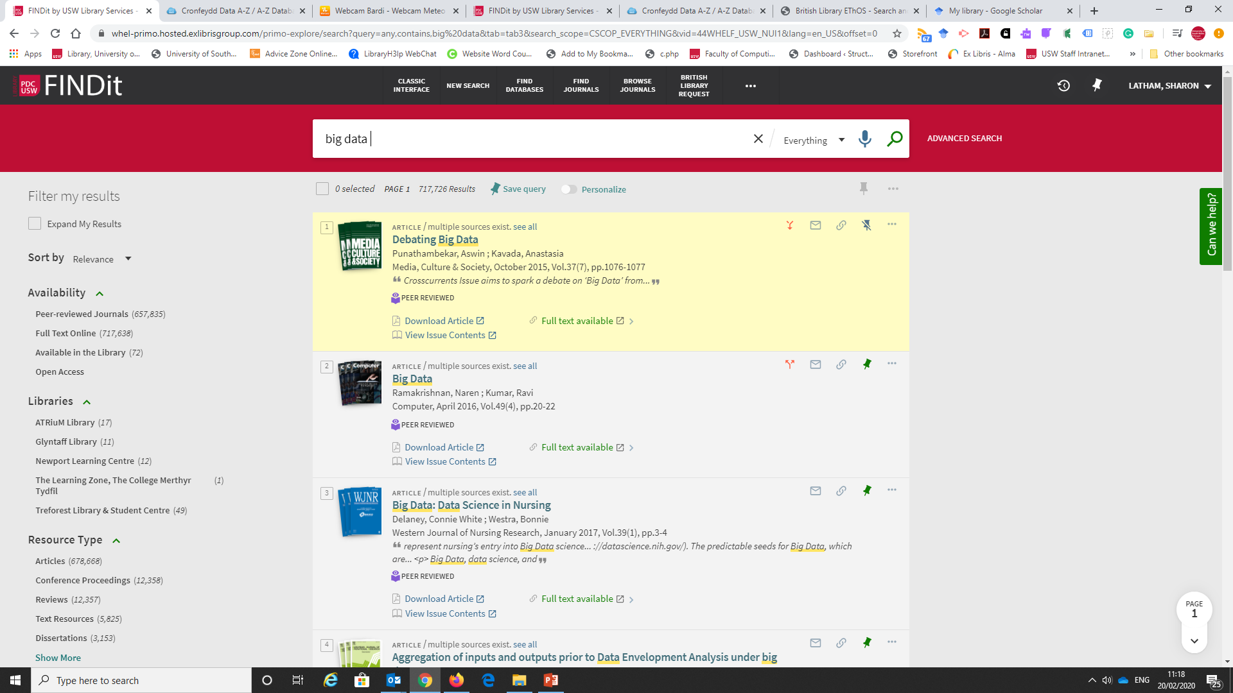
Save your search query
Always Log in
Find the other articles cited in this article
Shows it is a Peer Reviewed article
Pin/Save a record
Find other articles that have cited this article
Use the filters

Slide 26






FINDIT
Libraries
Articles
USW People
In the library
Subscriptions £
Every thing
Every th
I
ng
Full Text Journal Articles
Books
Staff publications
eBooks
Abstracts
Peer reviewed articles
DVDs & CDS
Conference Proceedings
Print Journals
Technical Papers

Slide 27
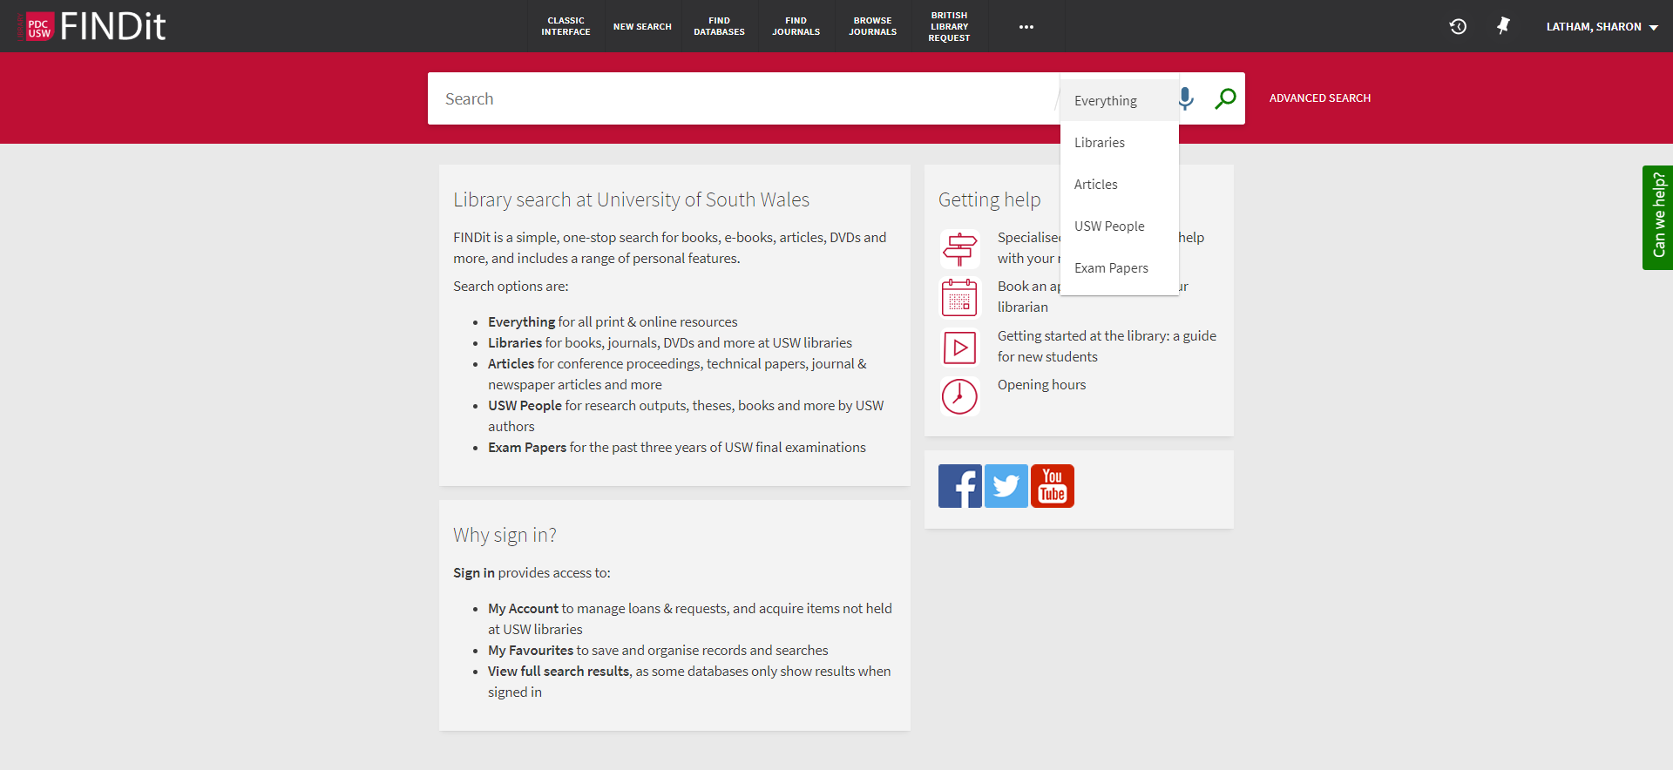

Slide 28



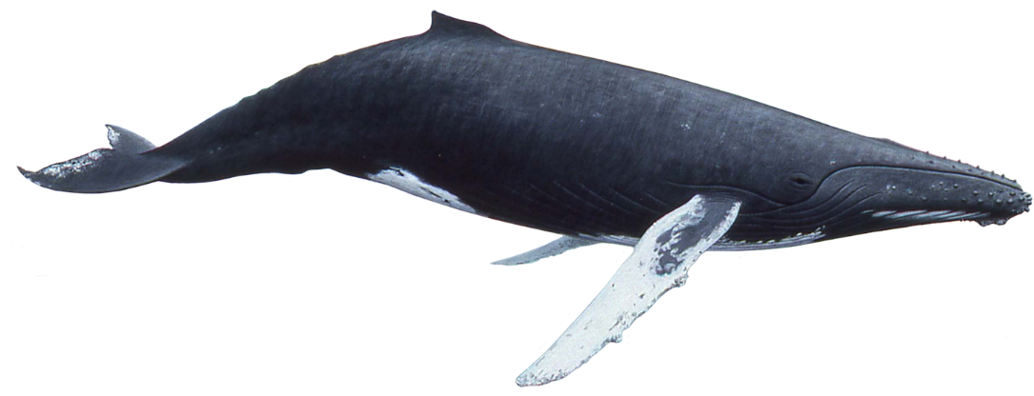
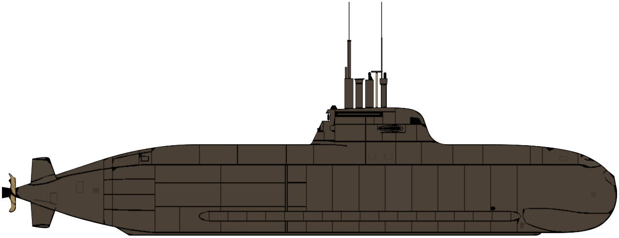
websites
Twitter
Blogs
Facebook
Wikipedia
Shopping
News
Google Scholar
FINDit – Library Search
Academic Databases

Slide 29
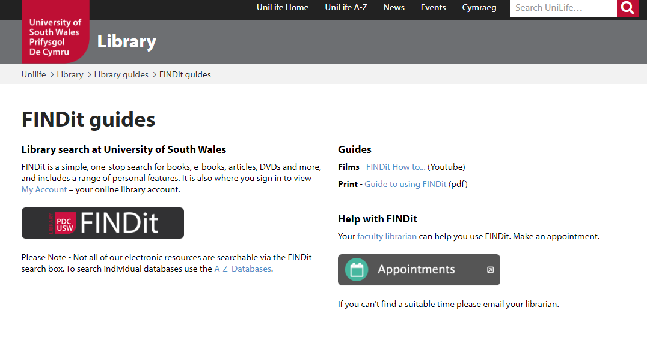
FINDit Films
https://library.southwales.ac.uk/collections-subject-guides/findit/

Slide 30

What are Peer Reviewed journal articles ?
Watch this short film

Slide 31
Subscription Databases

Slide 32
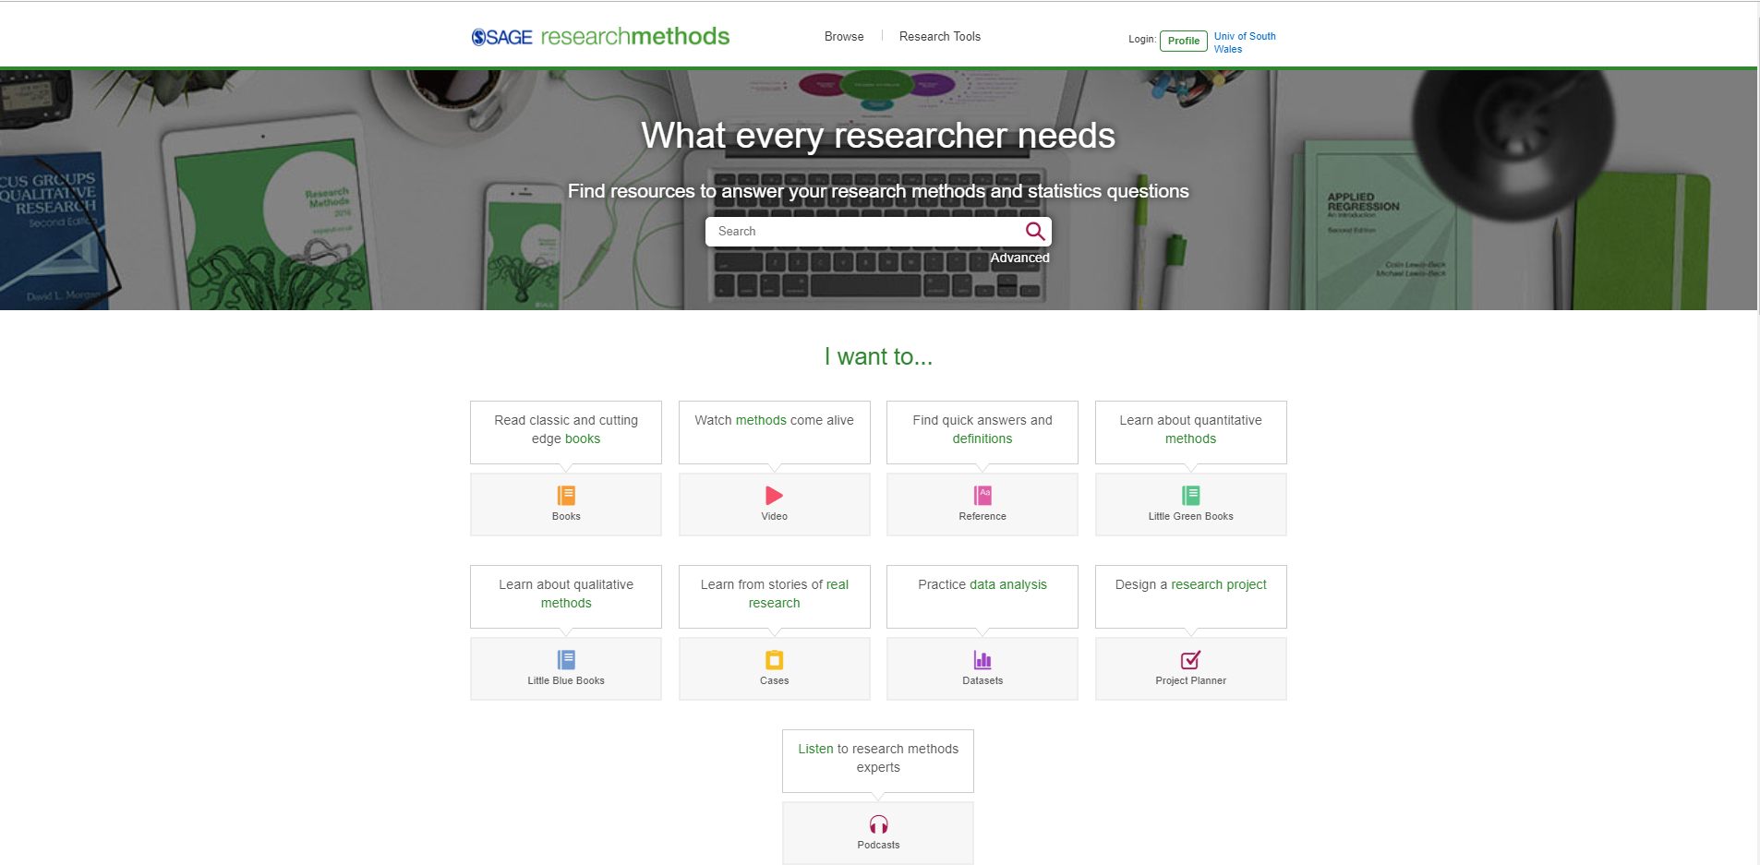
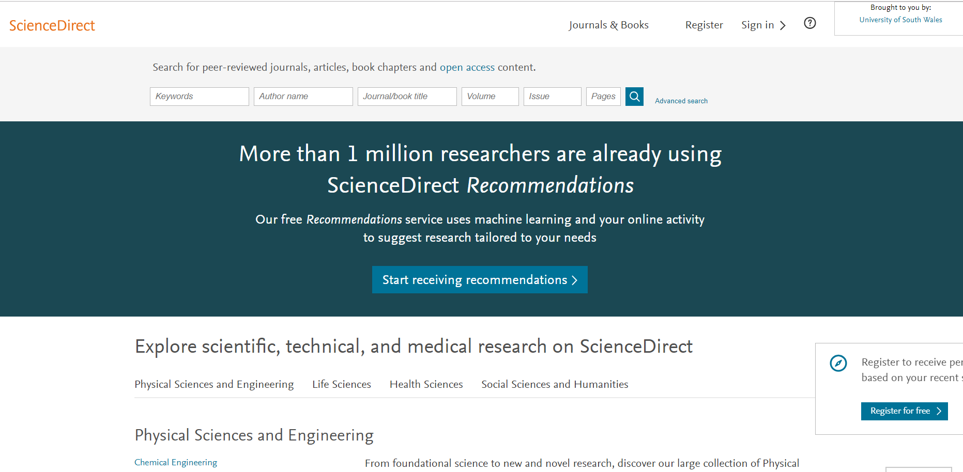
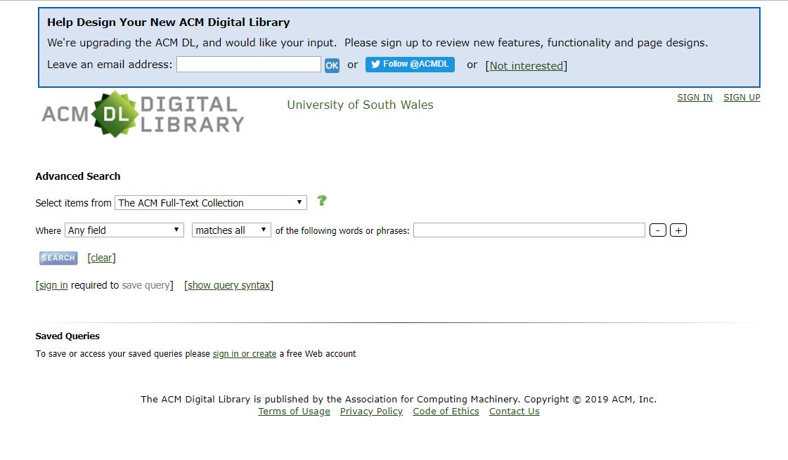
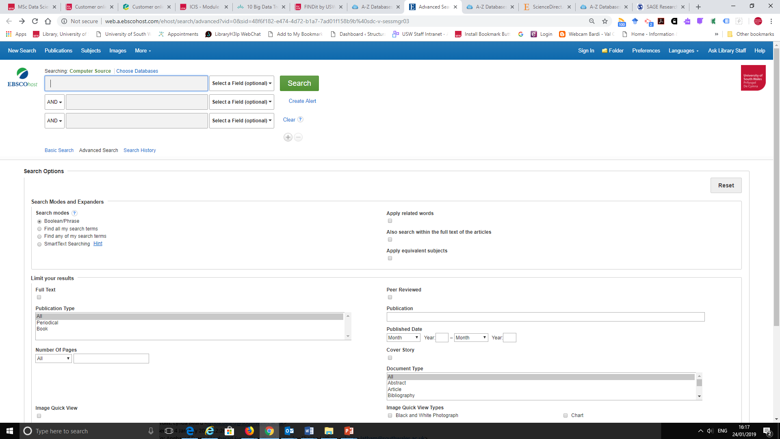
ScienceDirect
Sage Research Methods
Find more on the database page - http://libguides.southwales.ac.uk/az.php
ACM Digital Library
Computer Source

Slide 33
Demo
Find a database
Search for an article
Save the article
Set an alert

Slide 34
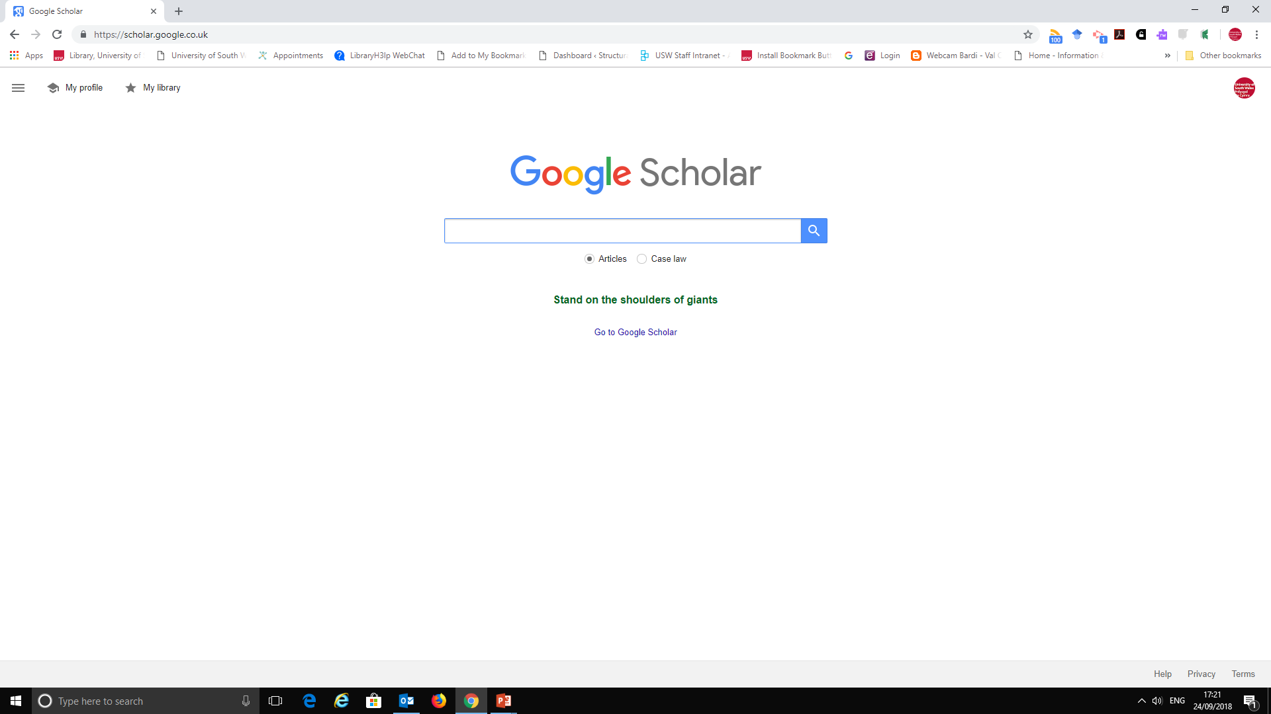
Indexes the full text or metadata of scholarly literature across an array of publishing formats and disciplines. Google Scholar index includes most peer-reviewed online academic journals and books, conference papers, theses and dissertations, preprints, abstracts, technical reports, and other scholarly literature.
Puts high weight on citation counts and words included in a document's title. As a consequence, the first search results are often highly cited articles.

Slide 35
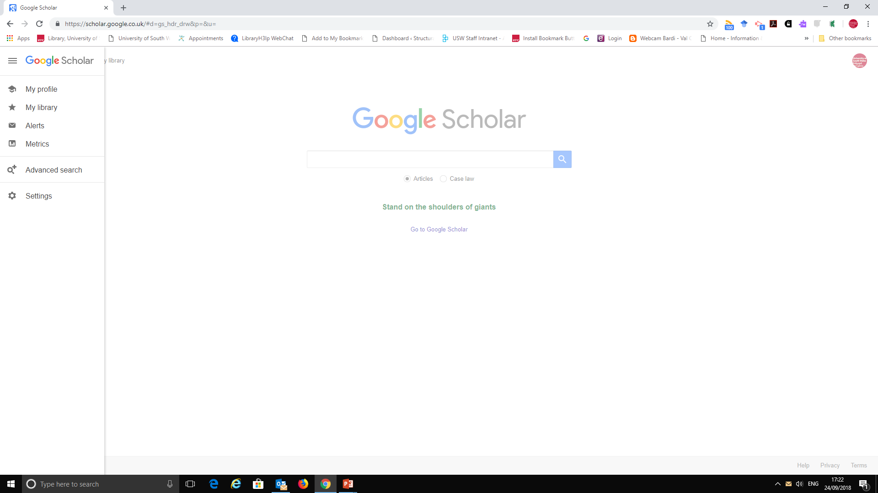

Slide 36
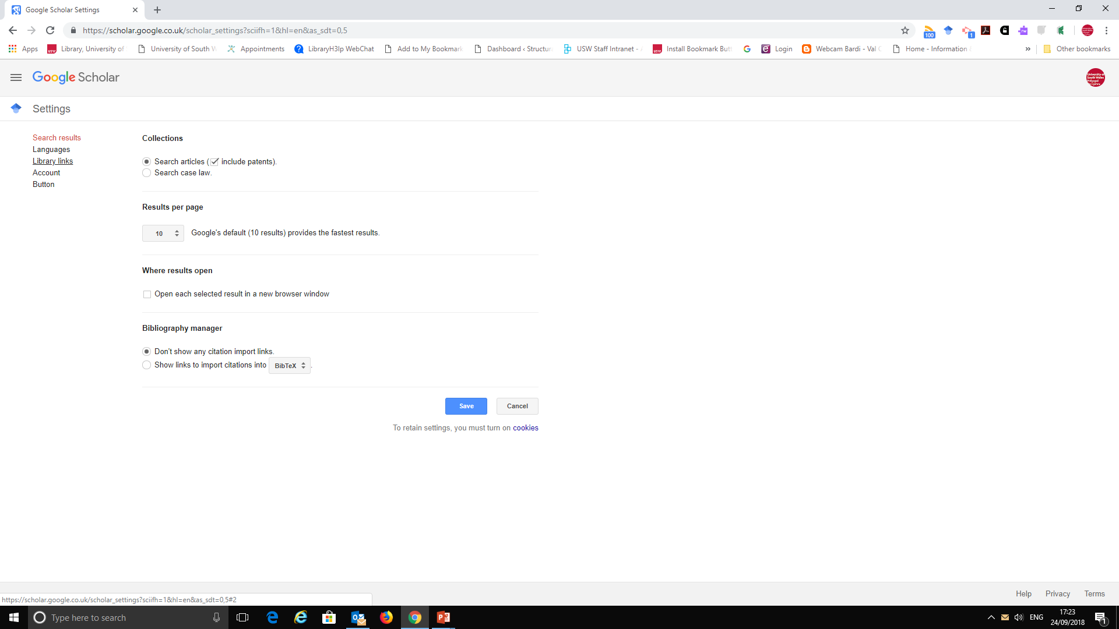

Slide 37
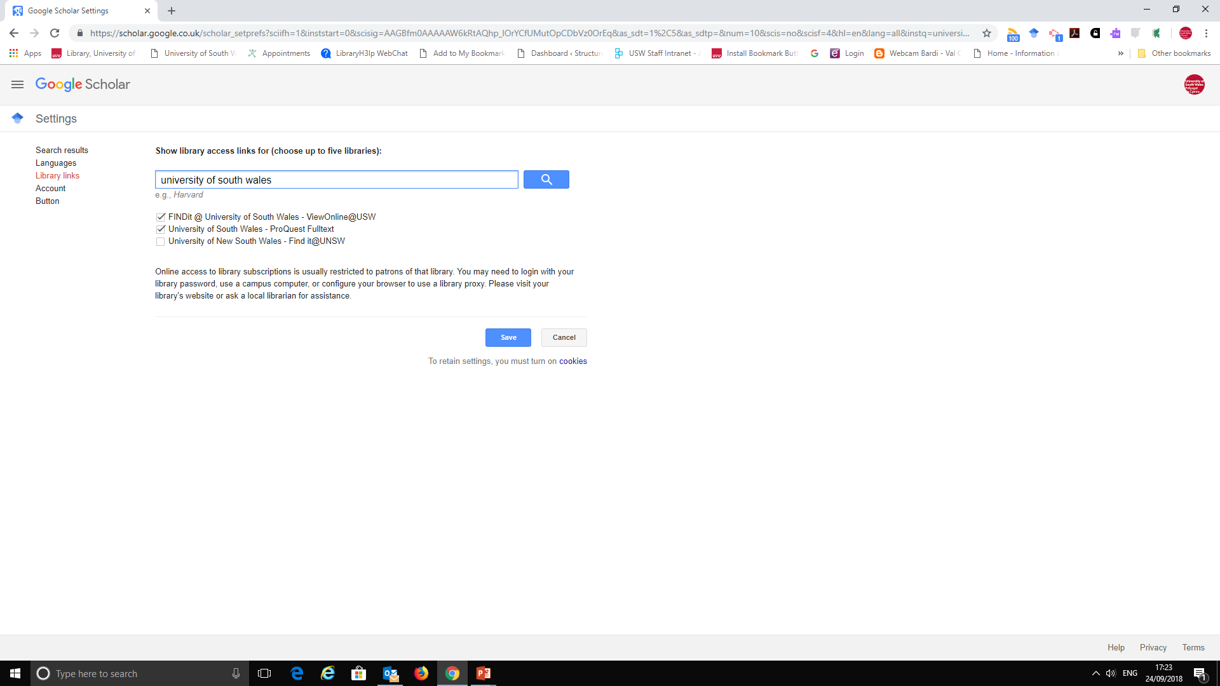

Slide 38
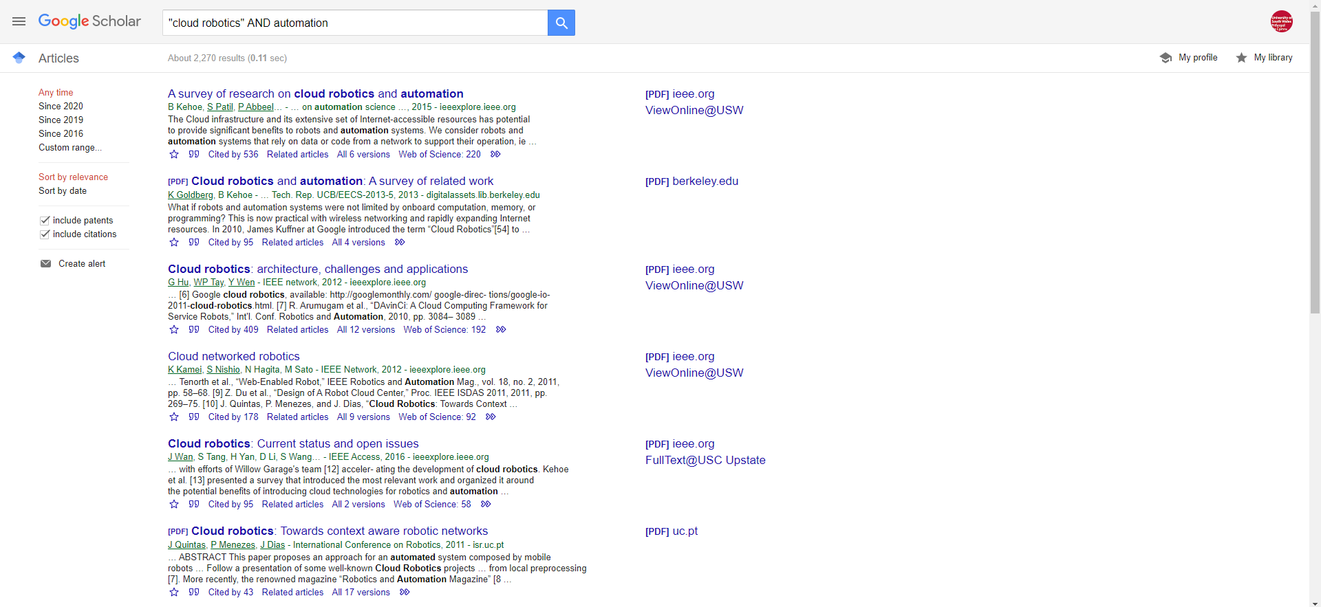
Add to my library click the star
Open in FINDit
Set alerts to have notificatios based on your search criteria

Slide 39
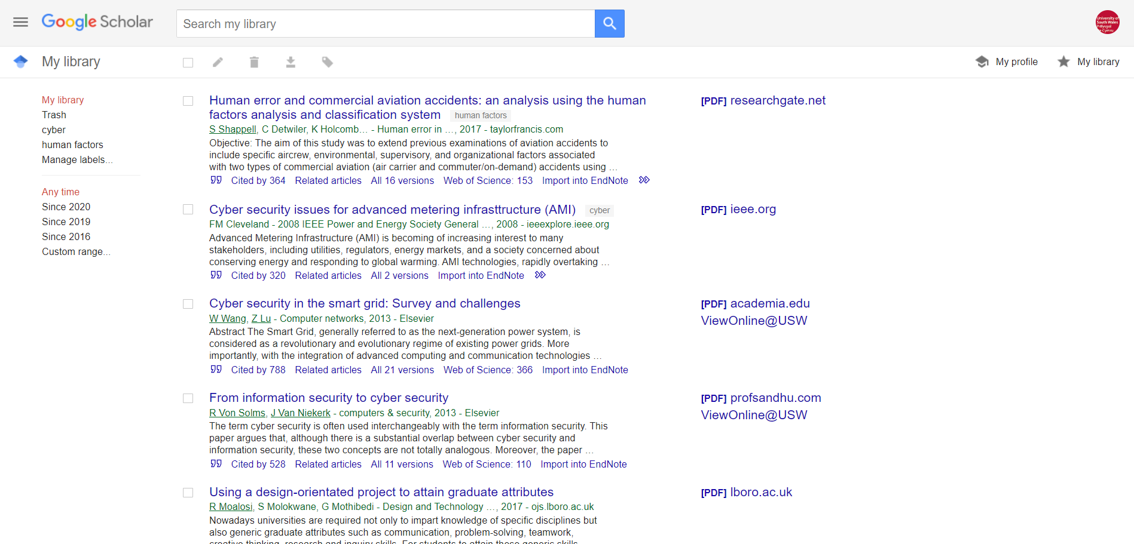
This is my library

Slide 40
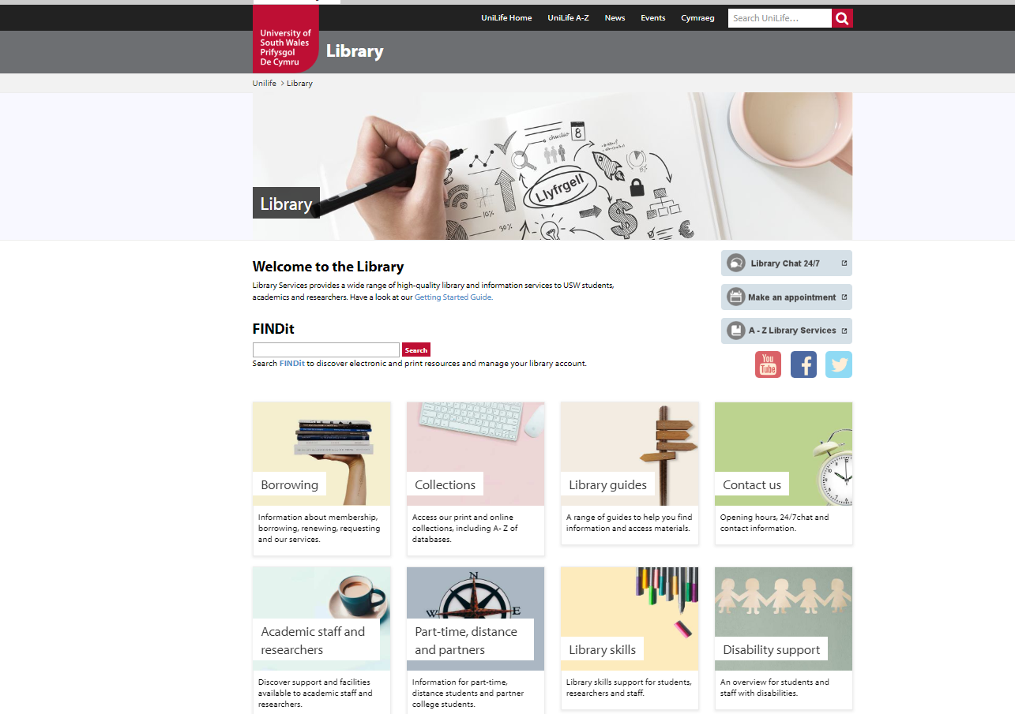
Help and Support Subject Guides

Slide 41
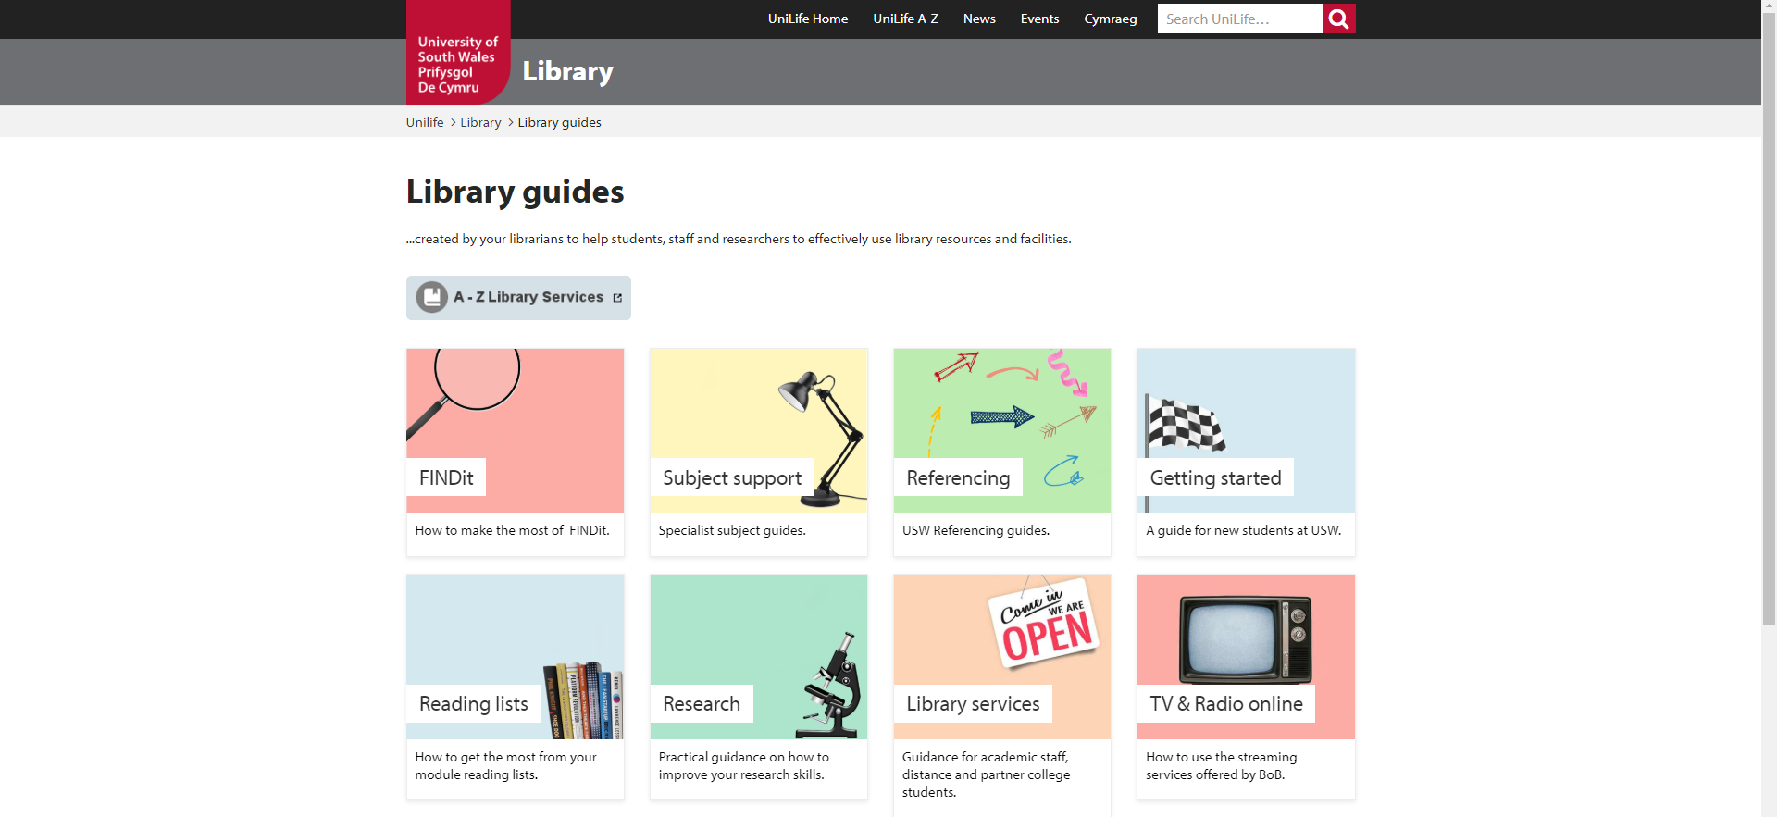
Find your referencing guide here
Find your subject guide here

Slide 42
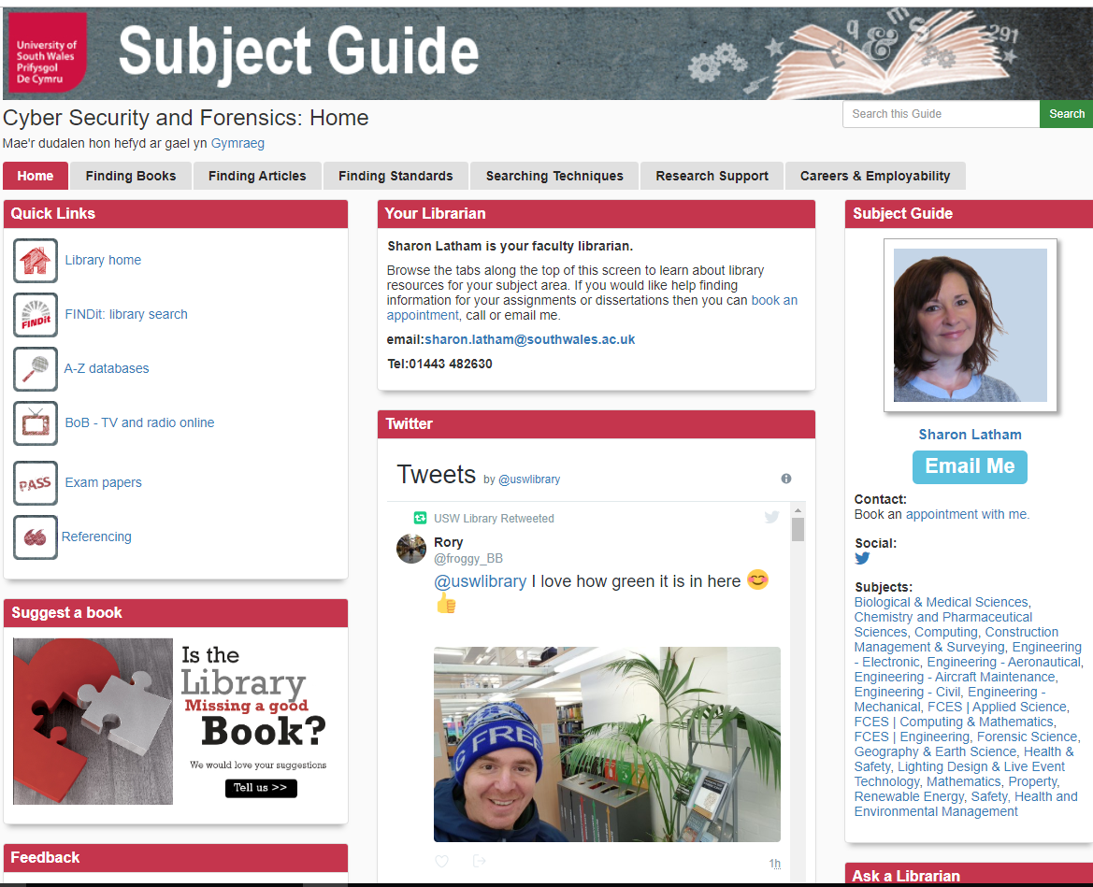
Help and Support Subject Guides

Slide 43




Help and Support Appointments

